Slide 1
Module C
Unit C3
Vocabulary
Language Functions
Speaking Activities
UTN FRVM Lic. Evangelina Cecchel - Lic. Bibiana Fernandez

Slide 2
Language Functions:
Asking for information
using embedded questions
UTN FRVM Lic. Evangelina Cecchel - Lic. Bibiana Fernandez

Slide 3
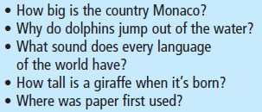

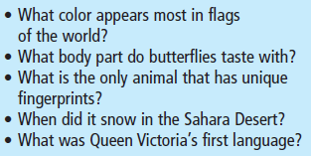
Activity: What Do You Know?
Ask your partner questions beginning with Do you know ? or Can you tell me?
Then your partner will answer the questions (look at the next slide)
Examples: Do you know what color appears most in flags of the world?
Can you tell me how big Monaco is?
UTN FRVM Lic. Evangelina Cecchel - Lic. Bibiana Fernandez

Slide 4
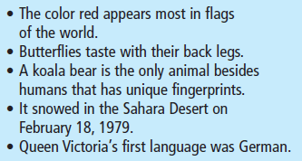
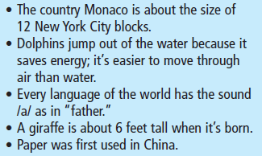
UTN FRVM Lic. Evangelina Cecchel - Lic. Bibiana Fernandez

